Slide 1
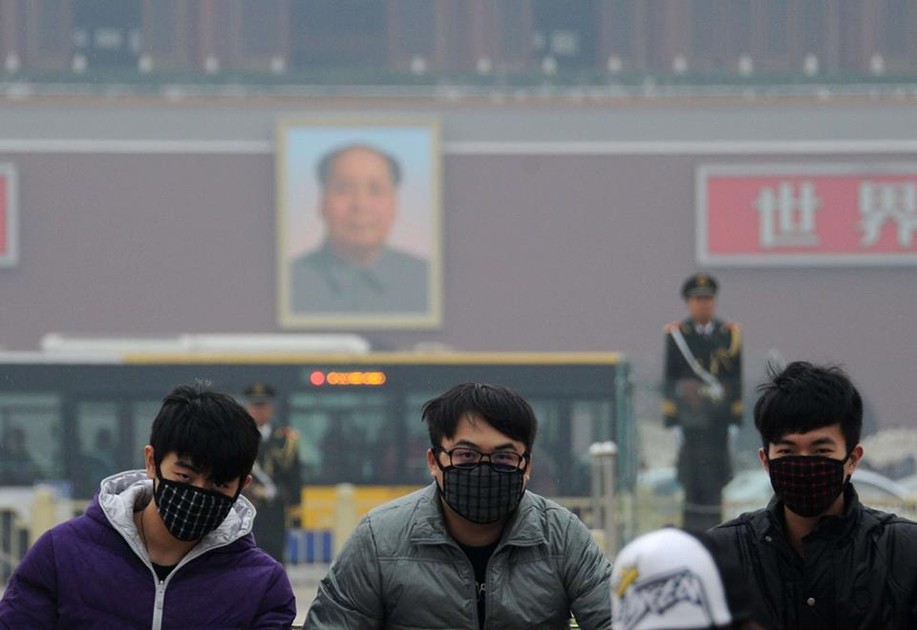
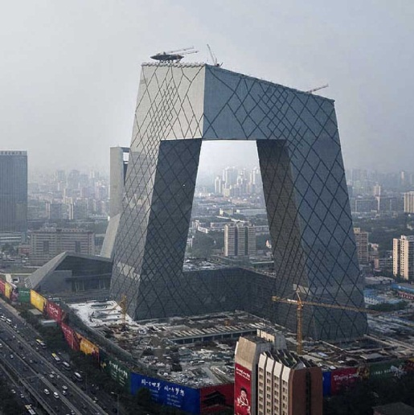
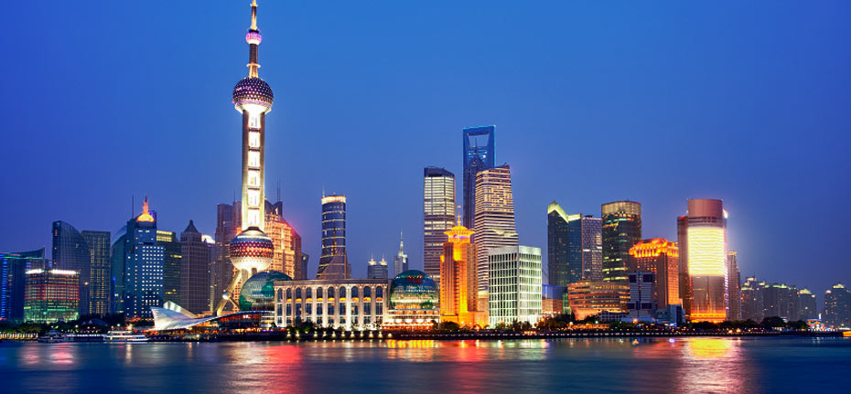
Urbanisation in China
Some statistics

Slide 2
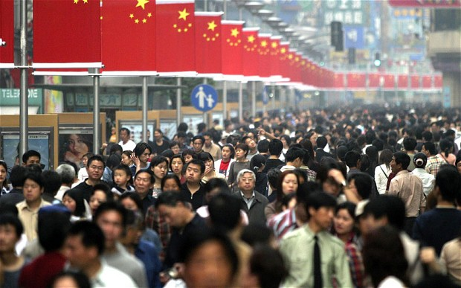
The People's Republic of China has a total urban population of 725 million or 54% of the total population, rising from 26% in 1990.
China faces increasing urbanization; according to predictions, nearly 70% of the population will live in urban areas by 2035.
http://www.unicef.org/sowc2012/urbanmap/

Slide 3
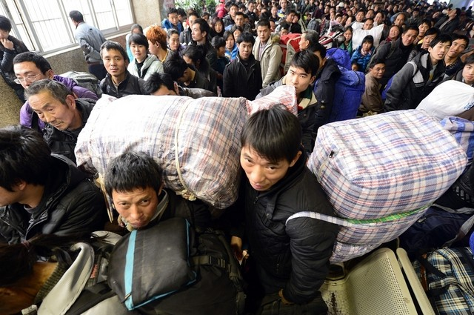

China has experienced the largest migration wave in human history with about 500 millions of its rural population moving to cities over the last 40 years!
http://www.youtube.com/watch?v=KNXg-kYk-LU

Slide 4
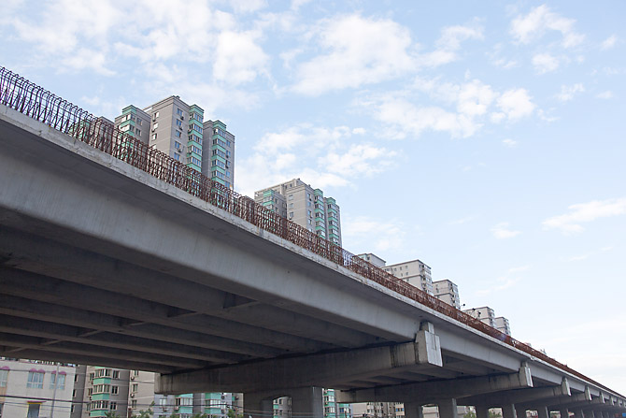
China's urbanization took 22 years to
increase from 17.9% to 39.1%.
It took Britain 120 years,
the US, 80 years,
and Japan
more than
30 years
to do
this.

Slide 5
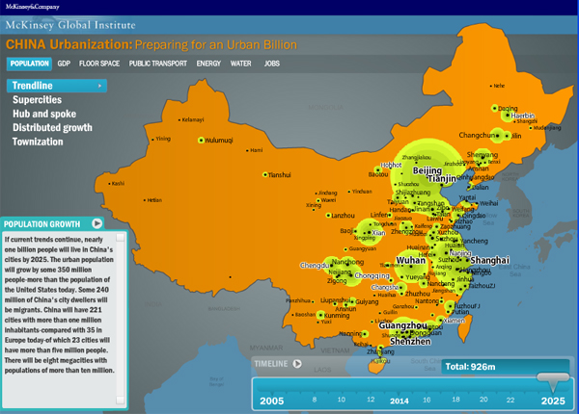

Slide 6
World urbanization growth
Urban population growth (%)
Region/country | 1985-1990 | 1990-1995 | 1995-2000 | 2000-2005
Asia | 3.78 | 3.09 | 2.88 | 2.61
South-East Asia | 4.11 | 3.99 | 3.84 | 3.40
East Asia | 4.08 | 3.08 | 2.82 | 2.52
China | 5.04 | 3.77 | 3.52 | 3.08
Europe | 0.78 | 0.37 | 0.14 | 0.13
North America | 1.24 | 0.57 | 1.51 | 1.37
Oceania | 1.52 | 1.52 | 1.46 | 1.40
World | 2.70 | 2.33 | 2.18 | 2.04

Slide 7
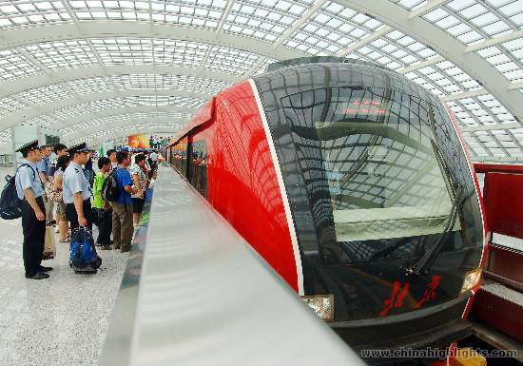
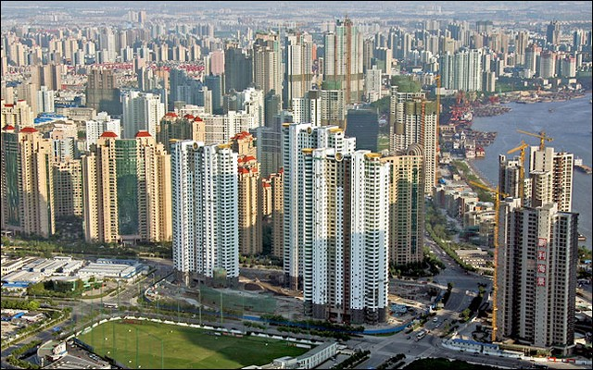
Over the next two decades China will build 20,000 to 50,000 new skyscrapers and more than 170 cities will require mass transit systems by 2025.
Since 1993 Shanghai has gone from no inner-city rail to 303 stations and nearly 500 km of tracks.
Shanghai already has 4,000 skyscrapers, almost double the number in New York. There are designs to build 1,000 more by the end of this decade.

Slide 8
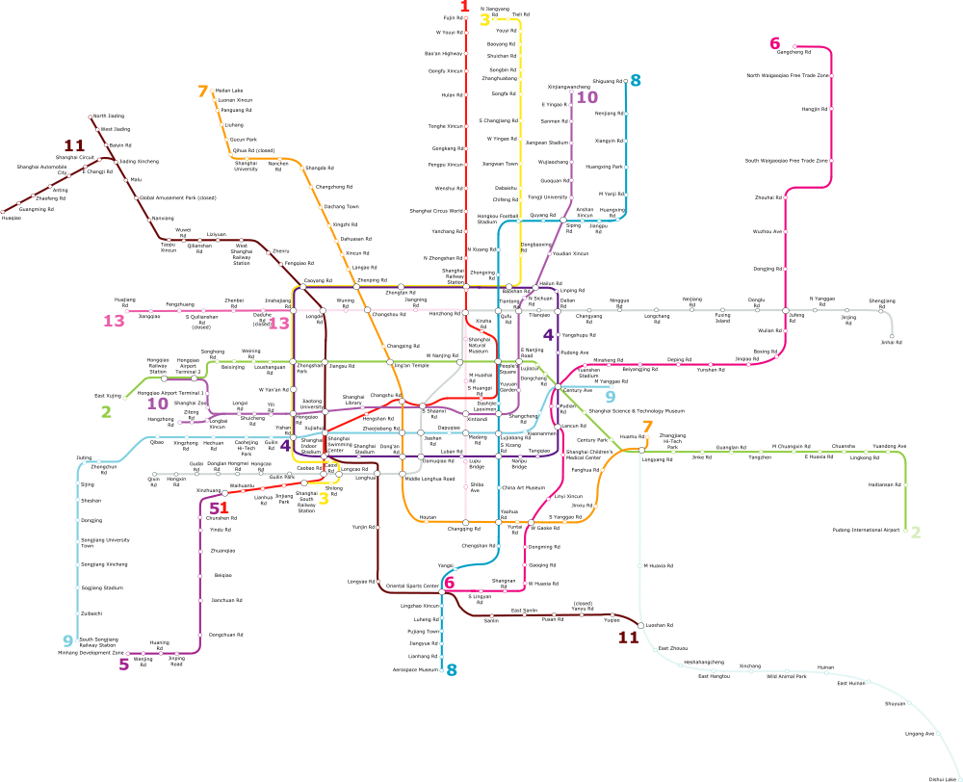

Slide 9
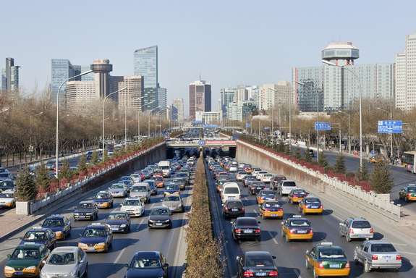
In 2005, China had 286 cities. Most of these cities have a population of one million and below.

Slide 10
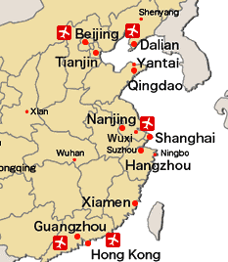
The four largest Chinese cities in 1985 were:
Shanghai, 7 million
Beijing, 5.9 million
Tianjin, 5.4 million
Shenyang, 4.2 million
Today:
Shanghai has 19 million
Beijing, 17.4 million.
These are the two mega-cities in China.

Slide 11
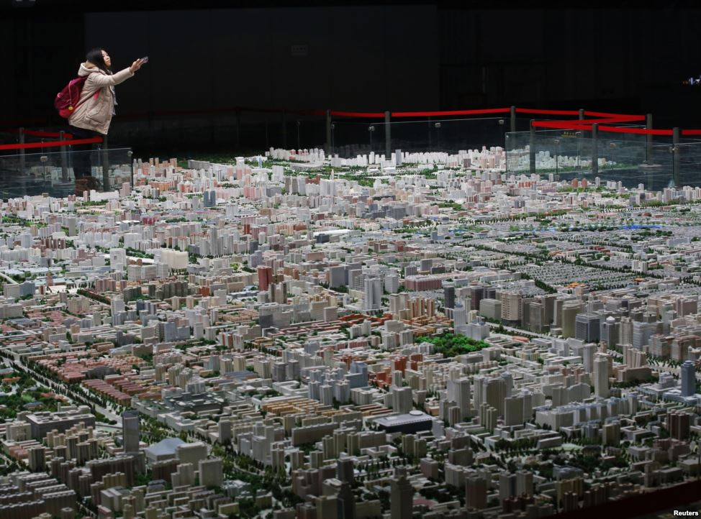
A recent model of Beijing

Slide 12
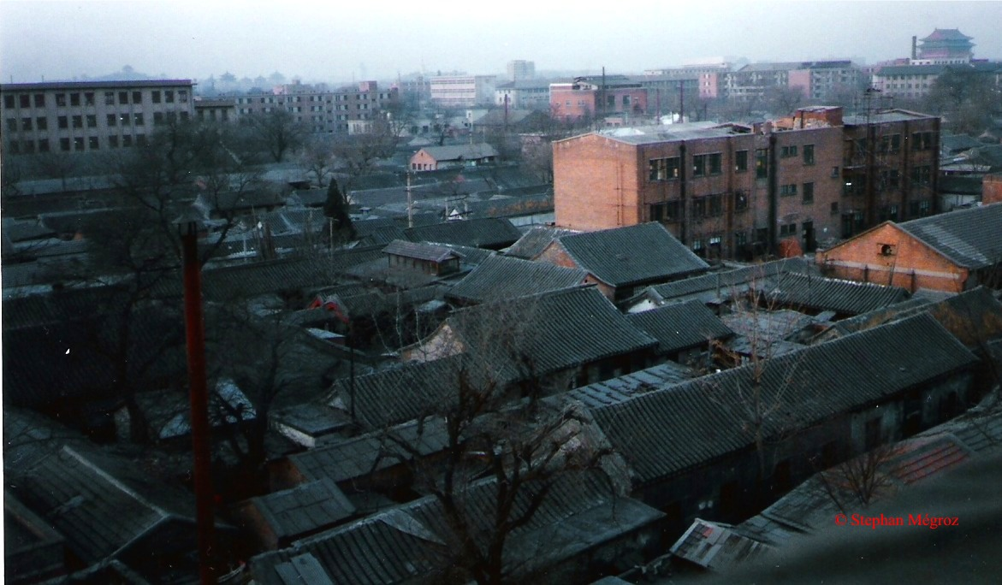
Beijing in 1989

Slide 13
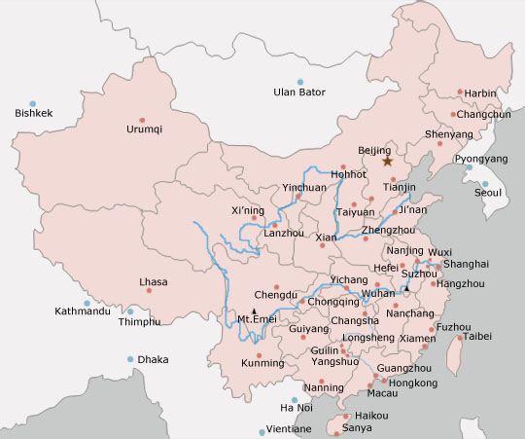
Some of China’s main cities

Slide 14
http://news.nationalgeographic.com/news/2013/11/131108-lung-cancer-childhood-china-pollution-eight-year-old-girl/?utm_source=Facebook&utm_medium=Social&utm_content=link_fb20131111news-lungcanc&utm_campaign=Content
http://www.lemonde.fr/asie-pacifique/article/2013/12/06/un-brouillard-de-pollution-paralyse-shanghai_3527010_3216.html

